Slide 1

Design & Implementation of
ETL & ELT Pipelines
for YouTube Trending Data
Princess Nora Bint Abdulrahman University
College of Computer and Information Sciences
Department of Information System | Group 2 | Section 63s
Team Members
Jood Ahmed Bagazi | Mashael Mohammed Algazlan | Reem Turki Alotaibi | Shoug Alghaihab | Nourah Almuharb

Slide 2
Presentation Agenda
What we'll cover today
01
Introduction & Background
05
ELT Pipeline Design
Problem statement and objectives
Extract → Load → Transform in PostgreSQL
02
System Design & Data Sources
06
ELT Implementation & Results
CSV, JSON, YouTube API
Neon PostgreSQL, automation, Power BI
03
ETL Pipeline Design
07
ETL vs ELT Comparison
Extract → Transform → Load into SQLite
Speed, scalability, efficiency
04
ETL Implementation & Results
08
Conclusion
Python code, output, and BI dashboard
Key takeaways and findings

Slide 3

Introduction & Problem Statement
Chapter 1 — Background and motivation
Background
Problem Statement
YouTube is one of the most widely used social media platforms worldwide, with billions of active users and massive daily content generation. This makes it an ideal source for data engineering applications.
Processing large-scale data efficiently requires choosing between
ETL and ELT — two approaches that differ in how and where data transformation is performed.
YouTube generates a large volume of daily data (views, likes, comments) that is difficult to handle at scale. Traditional approaches may lead to: • Slow performance
• High resource consumption
• Reduced system efficiency
Project Objectives
Collect YouTube data from multiple sources (CSV, JSON, API)
Compare ETL vs. ELT: execution speed, resource usage, scalability, and data quality
Design & implement an ETL pipeline — extract, transform, and load data
Analyze data to extract insights: popular categories, most viewed content, and engagement
Design & implement an ELT pipeline — extract, load raw data, then transform via SQL

Slide 4



System Design & Data Sources
Chapter 2 — Data collection and ingestion
USvideos.csv
US_category_id.json
YouTube Data API
Primary dataset of US trending YouTube videos. Contains title, channel, publish time, views, likes, dislikes, comment count, and category_id.
Maps numeric category IDs to readable names (Music, Entertainment, Gaming, Education, Sports…) for richer analysis.
Real-time metadata for selected categories: Music, Gaming, Entertainment, Comedy, Science & Tech, People & Blogs, Education. 5 results per category.
Data Ingestion: Batch Processing
ETL Batch
ELT Batch
Why Batch?
Data extracted from CSV & JSON files
Raw data loaded directly into PostgreSQL staging tables
Suitable for structured historical datasets
Additional data from YouTube API
Transformations run via SQL after loading
Easier to implement and debug
Python processes data before SQLite load
Preserves raw data for flexible re-use
Ideal for academic/analysis projects

Slide 5

ETL Pipeline Architecture
Chapter 3 — Extract → Transform → Load
EXTRACT
TRANSFORM
LOAD
USvideos.csv via pandas
dropna() — remove nulls
Load to SQLite (youtube_etl.db)
US_category_id.json mapping
drop_duplicates() — remove dupes
Table: youtube_data
YouTube Data API (7 categories, 5 results each)
Map category_id → category_name
if_exists='replace' for iterative dev
Convert publish_time to datetime
Export final_data.csv for BI
Create engagement = likes / views
Output: youtube_etl.db (SQLite) + final_data.csv (for Power BI visualization)

Slide 6
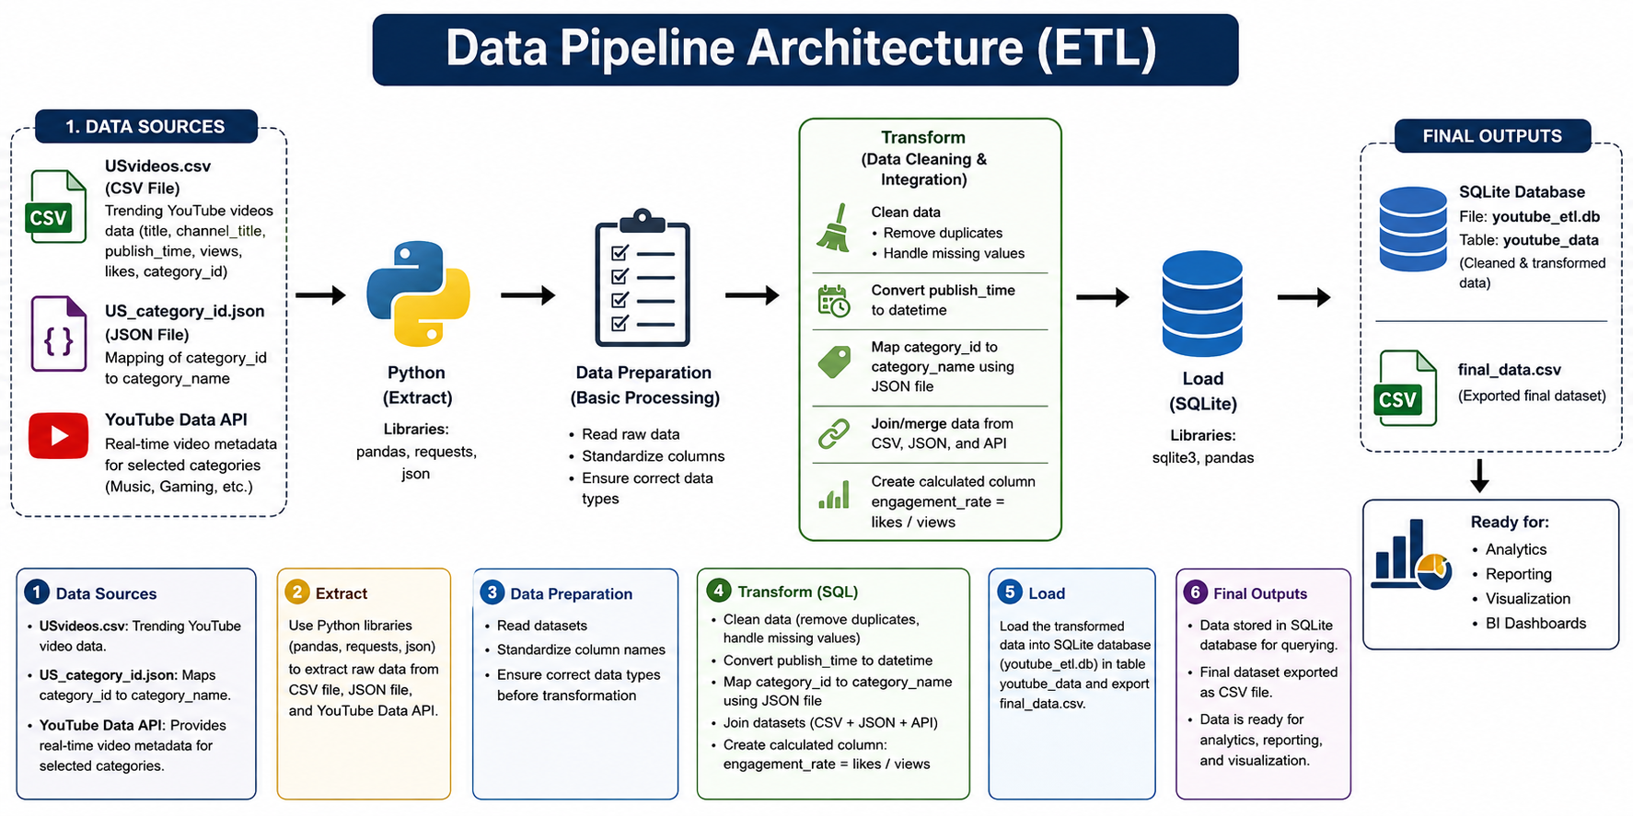

Slide 7
ETL Implementation — Python Code
Chapter 4 — Step-by-step pipeline execution
1. Extract — CSV & JSON
2. Transform — Clean & Enrich
3. Load — SQLite
df_csv = pd.read_csv("USvideos.csv")
with open("US_category_id.json") as f:
categories = json.load(f)
mapping = {int(item["id"]): item["snippet"]["title"]
for item in categories["items"]}
df_csv["category_name"] = df_csv["category_id"].map(mapping)
df_csv = df_csv[["title","channel_title",
"publish_time","views","likes","category_name"]]
df_csv["publish_time"] = pd.to_datetime(
df_csv["publish_time"], errors="coerce")
df_csv = df_csv.dropna().drop_duplicates()
df_combined = pd.concat([df_csv, df_api], ignore_index=True)
df_combined["engagement"] = (
df_combined["likes"] / df_combined["views"])
conn = sqlite3.connect("youtube_etl.db")
df.to_sql("youtube_data", conn,
if_exists="replace", index=False)
# Validation query
result = pd.read_sql("""
SELECT category_name, COUNT(*) AS total_videos
FROM youtube_data
GROUP BY category_name
ORDER BY total_videos DESC""", conn)

Slide 8


ETL Results & BI Dashboard
Chapter 4 — Output, query results, and visualization
1.6B
Music
9.5M
9,949
Total Views
Top Category
Positive Interactions
Entertainment Videos
Performance Challenges
⚠ Incorrect SQLite path
✓ Fix: Open DB with full absolute path
⚠ No such table error
✓ Fix: Re-run ETL script to recreate table
⚠ API key syntax error
✓ Fix: Place key in variable, use in f-string
⚠ Large API console output
✓ Fix: Remove print(data), use df.head()

Slide 9
Phase 2 — Introduction to ELT
Chapter 5 — Extract, Load, Transform
ETL — Extract, Transform, Load
ELT — Extract, Load, Transform
Flow
Flow
① Extract from source
① Extract from source
② Transform in Python/memory
② Load raw data to cloud DB
③ Load clean data to warehouse
③ Transform via SQL inside DB
Advantages
Advantages
Greater preprocessing control
Faster — raw data loads first
Data clean before storage
More scalable with cloud DBs
Better for small datasets
SQL transformations flexible
Tools Used: Python | Pandas | SQLAlchemy | Neon PostgreSQL (Cloud) | SQL Queries | Windows Task Scheduler

Slide 10


ELT Pipeline Architecture
Chapter 6 — Extract → Load → Transform (SQL in Neon PostgreSQL)
DATA SOURCES
EXTRACT & LOAD
TRANSFORM (SQL)
USvideos.csv — trending video data
Python + Pandas reads CSV & SQLite
JOIN stage_usvideos + stage_categories on category_id
youtube_elt_source.db — category info (SQLite)
SQLAlchemy connects to Neon PostgreSQL
COALESCE → handle missing category names
Attributes: video_id, title, views, likes, comments, category_id
Raw data → stage_usvideos (staging)
WHERE views > 0 — filter invalid records
Category data → stage_categories (staging)
engagement_rate = likes::numeric / views
Result stored in final_youtube_data table
Final output: final_youtube_data (Neon PostgreSQL) → Power BI Dashboard

Slide 11
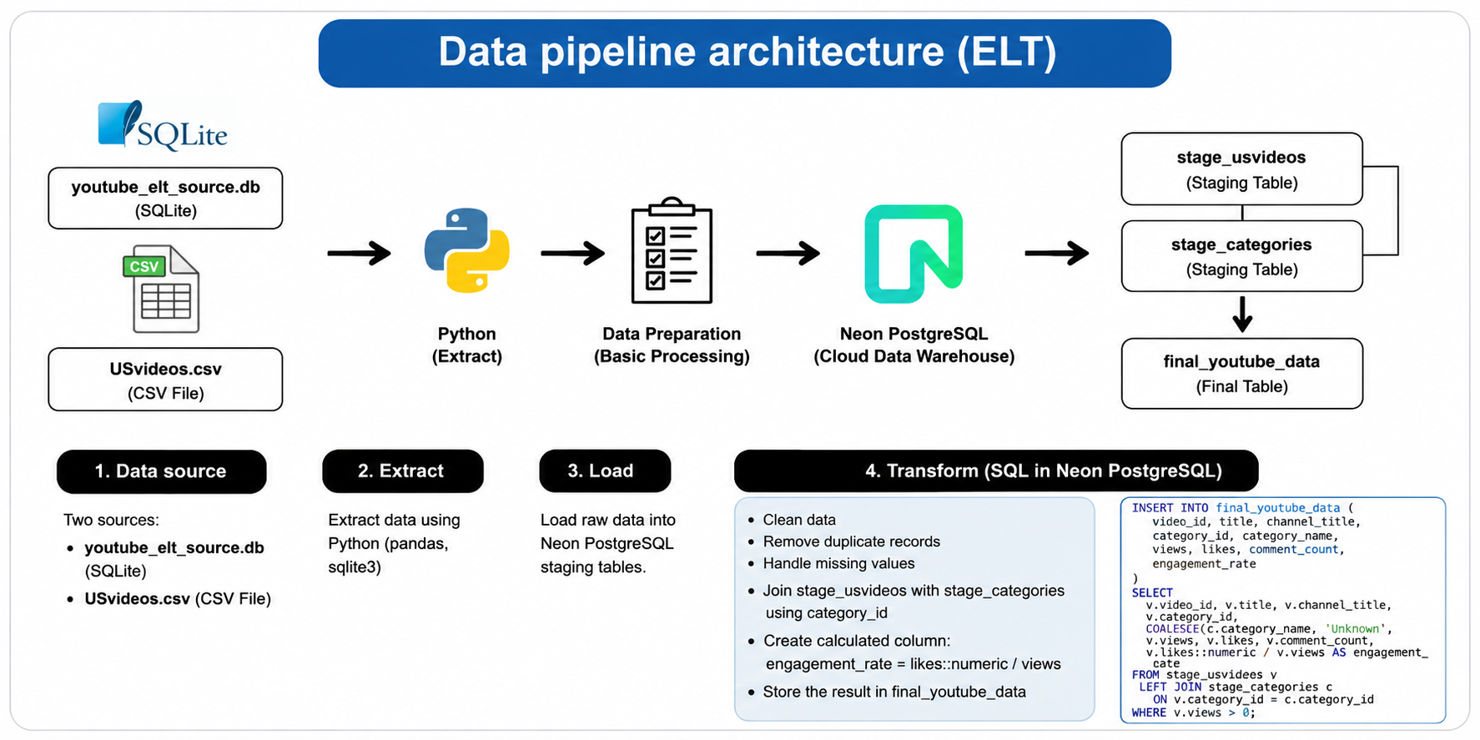

Slide 12
ELT — SQL-Based Transformation
Chapter 6.4 — Transform inside Neon PostgreSQL
SQL Transformation Script
Transformation Steps
DROP TABLE IF EXISTS final_youtube_data;
CREATE TABLE final_youtube_data (
video_id TEXT, title TEXT,
channel_title TEXT, category_id BIGINT,
category_name TEXT, views BIGINT,
likes BIGINT, comment_count BIGINT,
engagement_rate NUMERIC
);
INSERT INTO final_youtube_data (...)
SELECT
v.video_id, v.title, v.channel_title,
v.category_id,
COALESCE(c.category_name,'Unknown') AS category_name,
v.views, v.likes, v.comment_count,
v.likes::numeric / v.views AS engagement_rate
FROM stage_usvideos v
LEFT JOIN stage_categories c
ON v.category_id = c.category_id
WHERE v.views > 0;
SELECT * FROM final_youtube_data LIMIT 10;
1. Preview Staging
SELECT 10 rows from stage_categories and stage_usvideos to verify load
2. Drop & Recreate
Drop existing final_youtube_data table to ensure fresh transformation
3. JOIN Tables
LEFT JOIN stage_usvideos ↔ stage_categories on category_id
4. Handle Nulls
COALESCE maps missing category names to 'Unknown'
5. Calculate KPI
engagement_rate = likes::numeric / views per video
6. Filter Invalid
WHERE views > 0 removes zero-view records

Slide 13
ETL vs ELT — Performance Comparison
Chapter 7.4 — Speed, Scalability, Efficiency
Metric | ETL | ELT | Winner
Speed | ~6 seconds | ~0.5 seconds | ELT ✓
Scalability | Less scalable | More scalable | ELT ✓
Efficiency | Lower | Higher | ELT ✓
Preprocessing | Before load | After load | Depends
Raw data kept | No | Yes | ELT ✓
Best for | Small datasets | Large/cloud | Context
Key Finding
ELT is 12× faster than ETL (0.5s vs 6s) because transformations are performed inside Neon PostgreSQL using native SQL, avoiding heavy Python pre-processing. ETL remains preferable for smaller datasets requiring strict preprocessing before storage.

Slide 14

Automation & Power BI Dashboard
Chapter 7.2–7.3 — Visualization and scheduling
ELT Pipeline Automation
Power BI Dashboard Highlights
ELT Python script tested in VS Code
ETL Dashboard
Windows Task Scheduler configured
Total Views by Category (bar)
Likes Distribution (pie chart)
Task set to run daily automatically
Engagement Rate trend line
Python interpreter path selected
KPIs: 1.6B views, Top: Music, 9.5M likes
ELT Dashboard
ELT script path added to task config
11M Total Views
Task tested manually — confirmed success
484K Total Likes | 62K Comments
Views by Category & Channel
Scatter: views vs likes by category

Slide 15


Conclusion & Key Takeaways
Chapter 7.5 — Summary of findings
ETL Pipeline
ELT Pipeline
Successfully extracted YouTube data from CSV, JSON, and API. Transformed data in Python and loaded into SQLite. Full pipeline executed in Python with BI dashboard via Power BI.
Raw data loaded directly into Neon PostgreSQL staging tables. SQL transformations applied inside the database. Automated daily execution via Windows Task Scheduler.
ELT is 12× Faster
ETL for Control, ELT for Scale
ELT completed in 0.5s vs 6s for ETL — transformations inside the database engine are significantly more efficient than Python pre-processing.
ETL offers tighter control over preprocessing and data quality. ELT is more scalable and flexible for cloud environments and large datasets.
"Selecting the right pipeline architecture depends on data size, processing requirements, and system scalability."

Slide 16
Thank You
Questions & Discussion
References (IEEE Format)
[1] Statista, "Most Used Social Networks 2025," Apr. 2026.
[2] Microsoft, "ETL vs ELT: What's the Difference?" Microsoft Learn, 2023.
[3] AWS, "What is ETL?" Amazon Web Services, 2023.
[4] Google, "YouTube Data API Overview," Google Developers, 2024.
[5] SQLite, "About SQLite," SQLite Official Documentation, 2024.
[6] W. McKinney, Python for Data Analysis, 2nd ed. O'Reilly Media, 2017.
Princess Nora Bint Abdulrahman University | Department of Information System | Group 2

